Slide 1

SWARNANDHRa COLLEGE OF ENGINEERING AND TECHNOLOGY
DEPARTMENT OF CYBER SECURITY
COMMUNITY SERVICE project
REPORTED BY:
P.Vineetha
(24A25A4605)

Slide 2
TITLE: Aqua culture development: enhancing techniques for sustainable growth
🌊 Introduction:
Aquaculture—also known as fish farming. It is the practice of raising fishes, prawns, shellfish, and aquatic plants under controlled conditions.
As the world’s population increases and natural fish stocks decline, aquaculture has become an essential way to provide food, create jobs, and reduce pressure on wild water resources.
To ensure long-term success, aquaculture development focuses on sustainable techniques—such as improved farming systems, better feed and water quality management, disease prevention, and environmentally friendly technologies. By enhancing these techniques, aquaculture—including prawn farming and fish farming—can continue to expand while protecting ecosystems and ensuring the well-being of future generations.

Slide 3
🌱 Techniques for Sustainable Growth in Aquaculture:
Pond Culture Technique
Cage Culture Technique
Recirculating Aquaculture Techniques
Integrated Aquaculture techniques

Slide 4
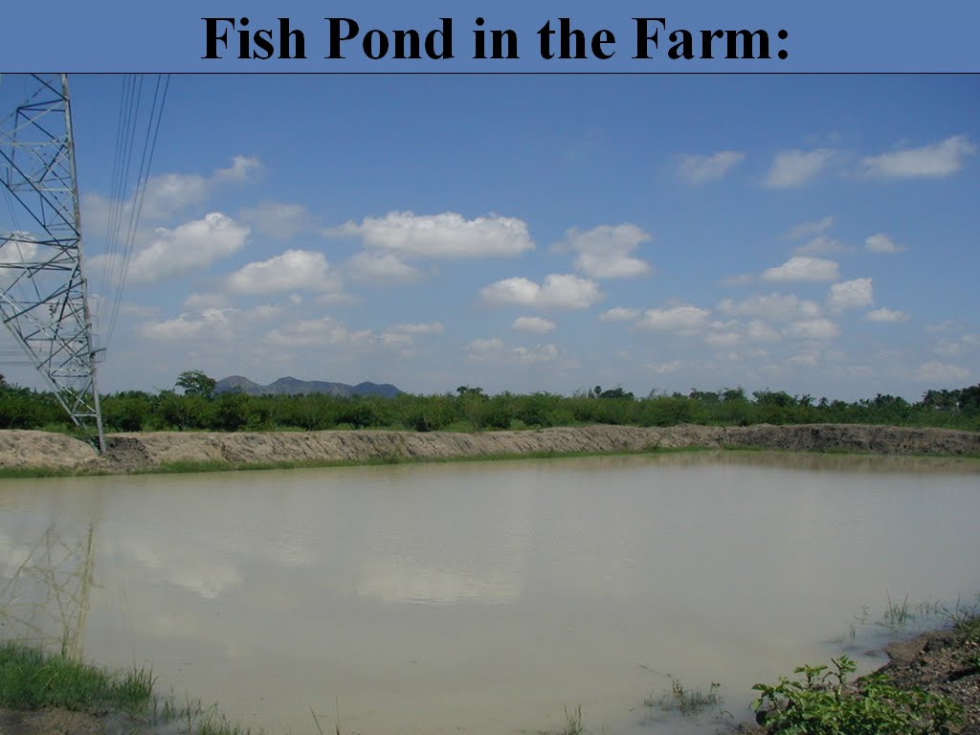
🌊 1.Pond Culture Techniques:
1.Pond Preparation
Cleaning the pond by removing weeds, mud, and unwanted fish.
Drying the pond bottom for a few days to kill germs.
Applying lime to make the water safe and balance the pH.
Adding fertilizer so natural fish food can grow

Slide 5
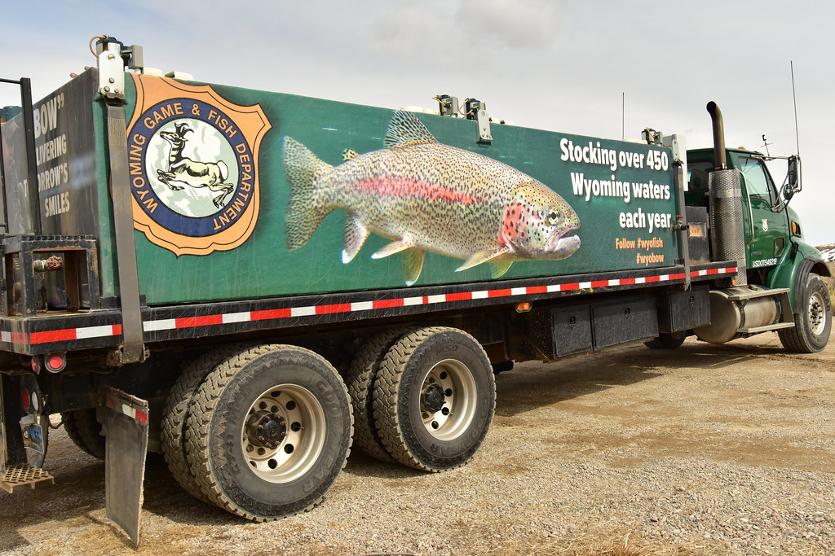
2. Stocking Fish
Choose healthy and active fingerlings from a trusted source.
Acclimate them by slowly mixing pond water with the water they came in, so they don’t get stressed.
Use the right number of fish for the pond size to avoid overcrowding.
Proper stocking increases survival and helps fish grow faster.

Slide 6
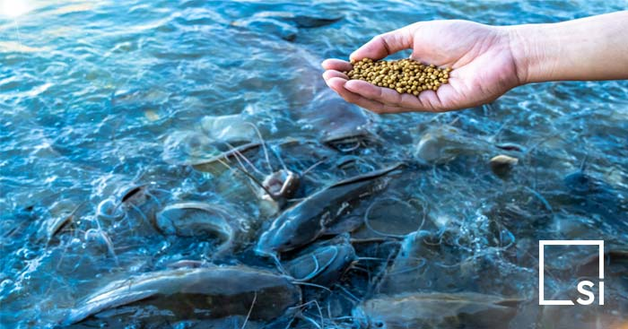
3. Feeding and Nutrition & Water Quality Management
Use nutritious feed that contains protein,
vitamins, and minerals.
Feed regularly, usually 2–3 times a day.
Avoid overfeeding, because extra feed sinks and spoils the water.
Farmers should check:
Temperature
pH level
Water color
They should:
Use aerators or paddle wheels to increase oxygen.
Change some water if it becomes dirty or smells bad.
Keep chemicals and pollutants away from the pond.

Slide 7
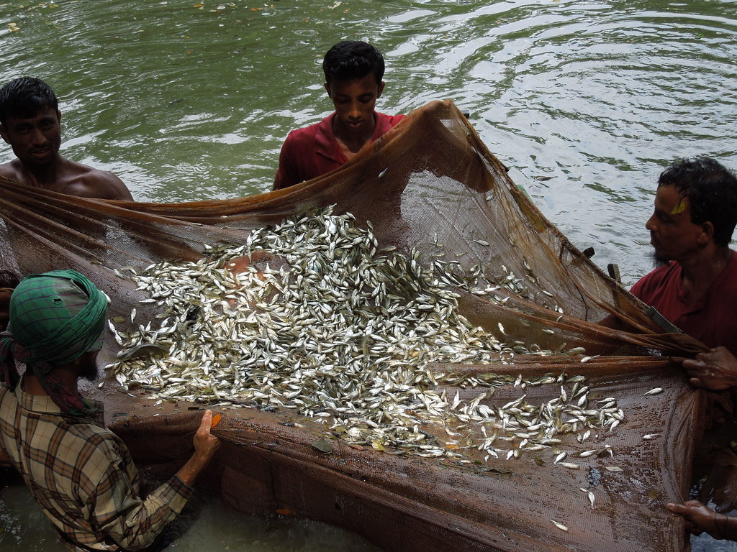
4.Harvesting and Post-Harvest Handling
.Use nets or sometimes drain the pond.
Handle the fish carefully to avoid hurting them.
Sort them by size if needed
Washing the fish to remove dirt.
Sorting and grading by size and quality.
Keep the fish on ice or in cold boxes to maintain
freshness.
Transporting quickly to the market.
This Photo by Unknown Author is licensed under CC BY-NC-ND

Slide 8
🏡 Village Description – Pasaladeevi
Pasaladeevi is a small coastal village known for its close connection to water bodies such as ponds, canals, and backwaters. Most families depend on fishing and aquaculture as their main source of income. The village has a calm environment, fertile land, and good availability of natural water resources, making it suitable for fish and prawn farming.
The people of Pasaladeevi are hardworking and skilled in traditional aquaculture practices, especially shrimp and fish culture. However, many farmers still use old methods, which sometimes lead to low production, disease outbreaks, and water pollution. With proper training and modern sustainable techniques, the village has great potential to improve aquaculture productivity and income. Therefore, the community service project aims to support Pasaladeevi by introducing environment-friendly, cost-effective, and sustainable aquaculture techniques.

Slide 9
📝 Village Survey – Pasaladeevi (For Aquaculture Development Project)
1. Purpose of the Survey
The survey aims to understand the existing aquaculture practices in Pasaladeevi and identify areas where sustainable techniques can be introduced to improve production and protect the environment.
2. Survey Findings
a) Aquaculture Practices in the Village.
b) Water Resources
c) Pond Management Practices
d) Stocking and Fish Seed Availability
e) Feeding and Nutrition
f) Disease and Health Management
g) Harvesting and Post-Harvest Handling

Slide 10
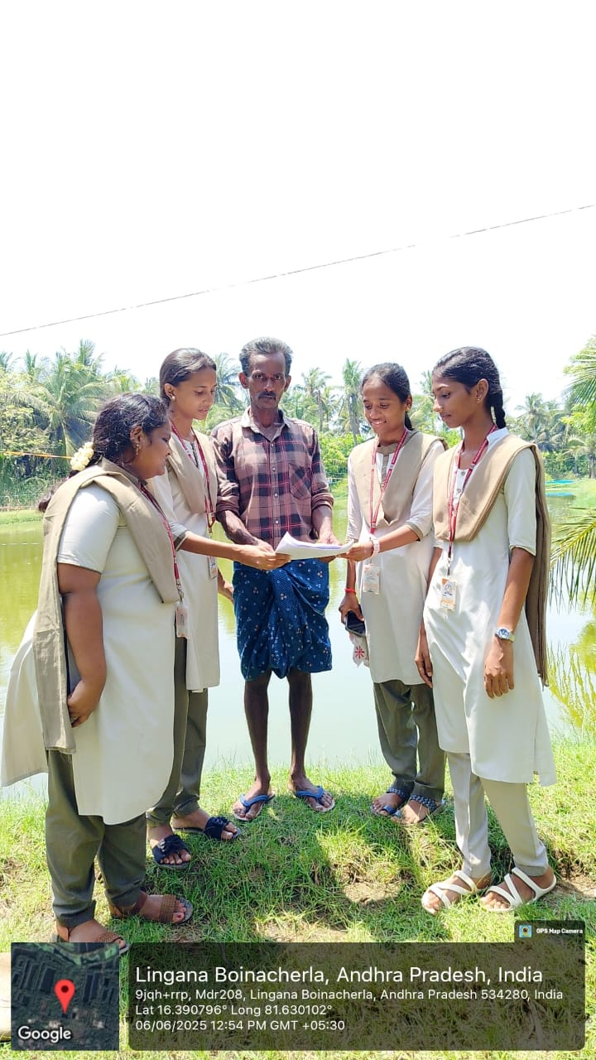
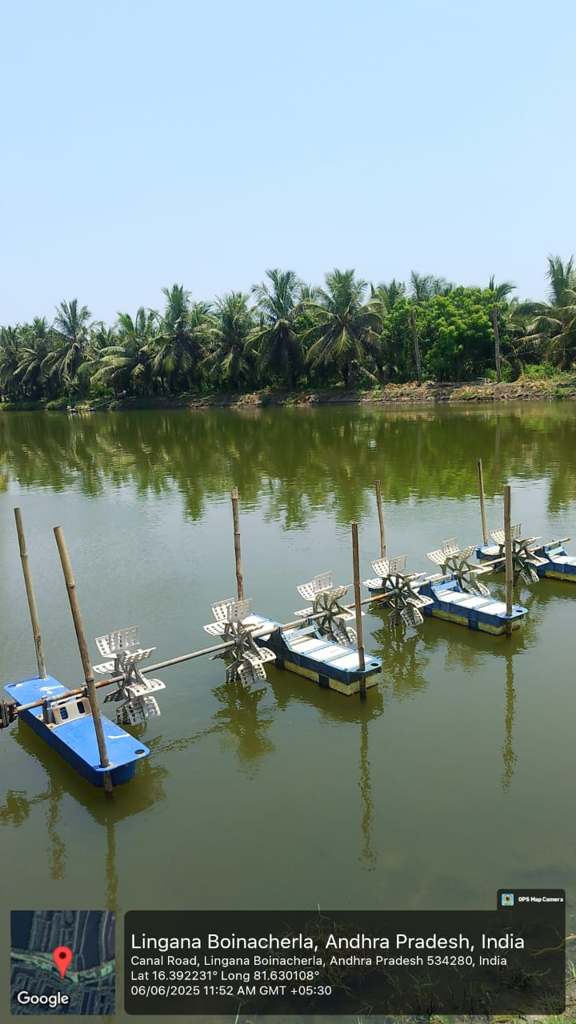
Survey Photos:

Slide 11
THANKYOU!

